Slide 1
Practical I
Bayesian Inference & Monte Carlo Sampling

Slide 2
1.
The model problem
Inferring the Gauss coefficients of the Earth’s magnetic field

Slide 3
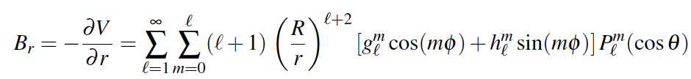
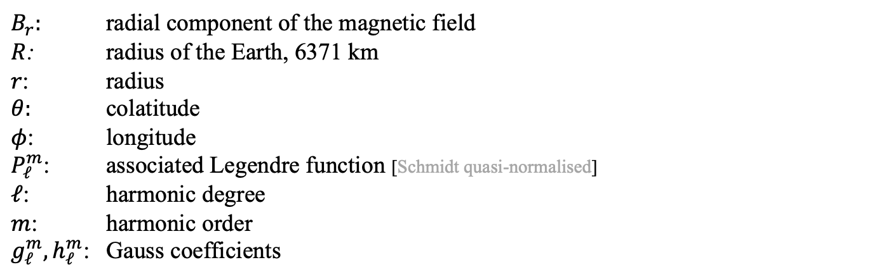
Gauss’ representation of the Earth’s magnetic field
Radial component of the geomagnetic field
$B_{r}:$ radial component of the magnetic field
$R$: radius of the Earth, 6371 km
$r$: radius
$θ:$ colatitude
$φ$: longitude
$P_{ℓ}^{m}$: associated Legendre function [Schmidt quasi-normalised]
$ℓ$: harmonic degree
$m$: harmonic order
$g_{ℓ}^{m}, h_{ℓ}^{m}$: Gauss coefficients

Slide 4
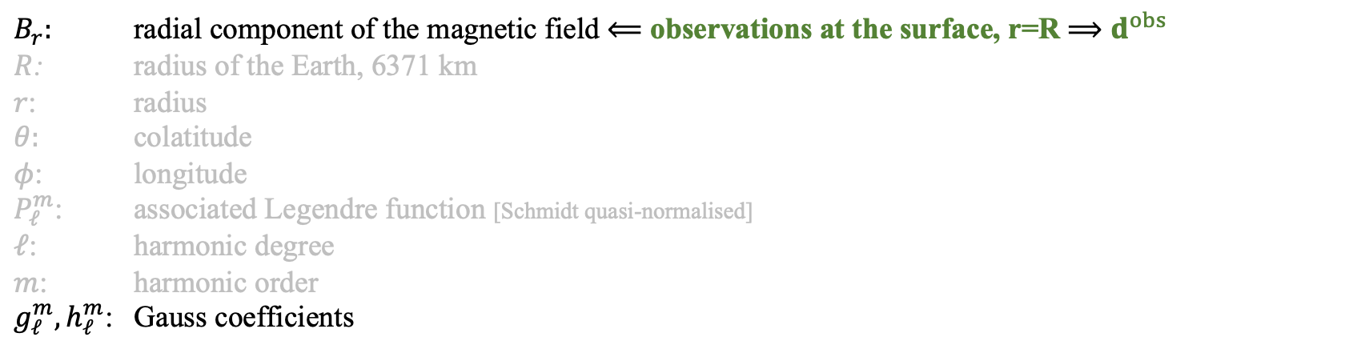
Gauss’ representation of the Earth’s magnetic field
Radial component of the geomagnetic field
$B_{r}:$ radial component of the magnetic field $⟸$ observations at the surface, r=R $⟹$ $d^{obs}$
$R$: radius of the Earth, 6371 km
$r$: radius
$θ:$ colatitude
$φ$: longitude
$P_{ℓ}^{m}$: associated Legendre function [Schmidt quasi-normalised]
$ℓ$: harmonic degree
$m$: harmonic order
$g_{ℓ}^{m}, h_{ℓ}^{m}$: Gauss coefficients

Slide 5
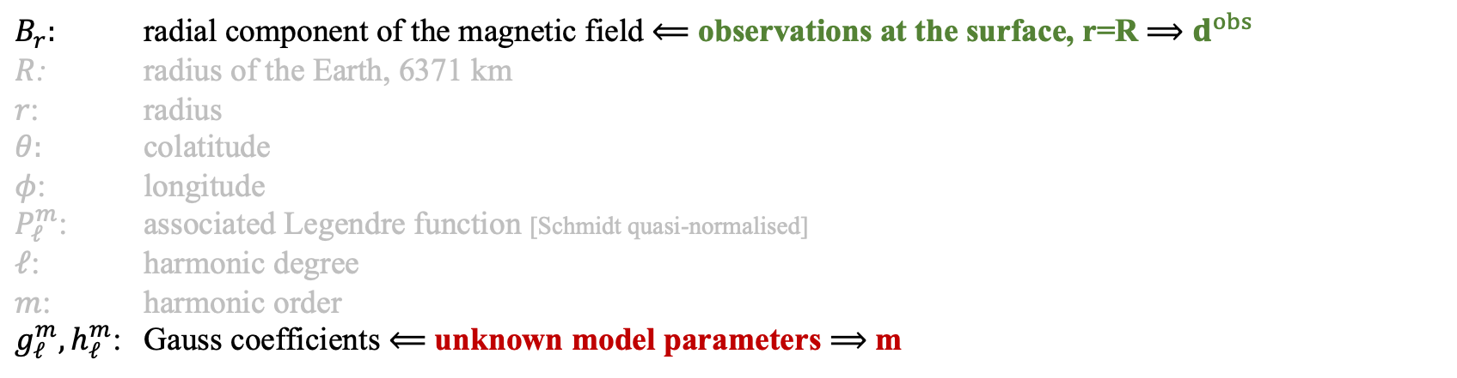
Gauss’ representation of the Earth’s magnetic field
Radial component of the geomagnetic field
$B_{r}:$ radial component of the magnetic field $⟸$ observations at the surface, r=R $⟹$ $d^{obs}$
$R$: radius of the Earth, 6371 km
$r$: radius
$θ:$ colatitude
$φ$: longitude
$P_{ℓ}^{m}$: associated Legendre function [Schmidt quasi-normalised]
$ℓ$: harmonic degree
$m$: harmonic order
$g_{ℓ}^{m}, h_{ℓ}^{m}$: Gauss coefficients $⟸$ unknown model parameters $⟹$ m

Slide 6
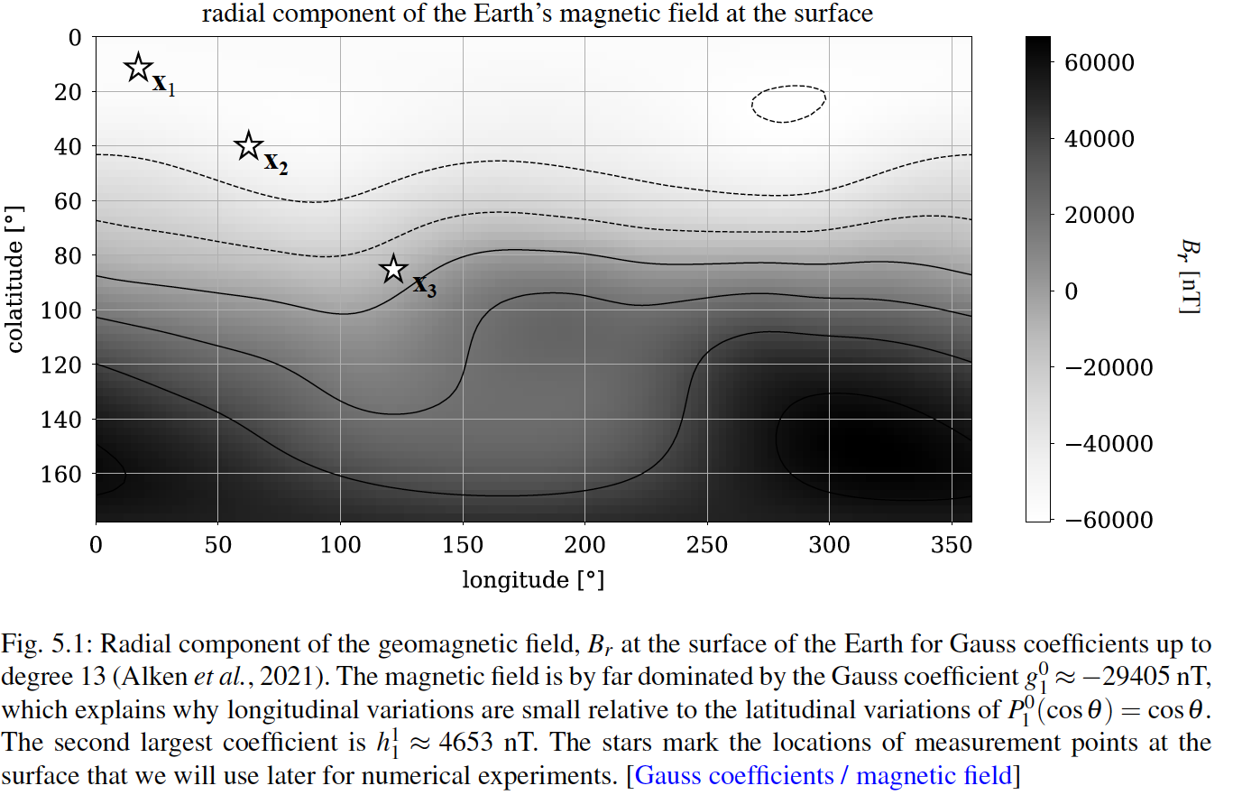
Gauss’ representation of the Earth’s magnetic field

Slide 7

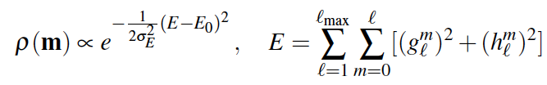
Prior knowledge
Gaussian observational errors
Finite energy of the magnetic field

Slide 8
2.
Jupyter notebooks

